Slide 1
Securing Your Microservices with a Declarative Model

Slide 2

The role of security in microservices
The problem with the status quo What OAuth 2.0 is all about
Overview
How Spring supports OAuth 2.0
The authorization code grant type Options for authorization servers
Summary

Slide 3




The Role of Security in Microservices
User authentication and authorization
Single sign-on and token management
Data and network security
Need for interoperability

Slide 4

Problems with the Status Quo
Credentials embedded in applications
Unnecessary permissions Differentiating users and machines Not optimized for diverse clients

Slide 5
Spring (Cloud) Security
Service authorization powered by OAuth 2.0.

Slide 6
What is OAuth 2.0?
Protocol for conveying authorization
Provides authorization flow for various clients
Obtain limited access to user accounts
Separates idea of user and client
Access token carries more than identity
NOT an authentication scheme

Slide 7


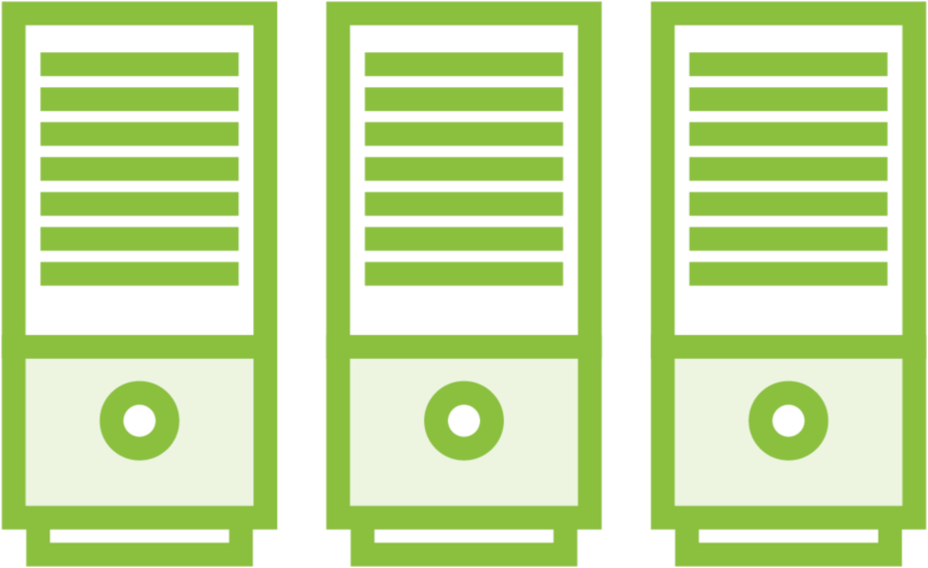

Actors in an OAuth 2.0 Scenario
Resource Owner Entity that grants access to a resource.
Usually, you!
Resource Server Server hosting the protected resource.
Client
App that’s making protected resource requests on behalf of resource owner.
Authorization Server
Server issuing access tokens to clients.

Slide 8

Glossary of OAuth 2.0 Terms
Access Token
Refresh Token Scope
Client ID / Secret OpenID Connect JWT

Slide 9
How Spring Supports OAuth 2.0
Broad auto-configuration for clients and resource servers
Deep support for standard OAuth 2.0 flows
Integrates with RestTemplate and WebClient
Many extensibility points

Slide 10
Abstract OAuth Flow
Client
(1) Authorization Request
Resource Owner
(2) Authorization Grant
(3) Authorization Grant
Authorization Server
(4) Access Token
(5) Access Token
Resource Server
(6) Protected Resource

Slide 11
OAuth 2.0 Grant Type: Authorization Code
User
Web App
Auth Server
Secure API
1
Log into the app
2
Request authorization code
Redirect user to login and authorization prompt
3
4
Authenticate and provide consent
Provide authorization code
5
6
Send authorization code, client ID, and client secret
Validate code, ID, and secret
7
Return token
8
9
Request secure data using access token
Validate token
10
Return secure data
11

Slide 12
Demo
Build Toll reporting site
Add Spring Security with OAuth2 login Authenticate and authorize via GitHub Watch redirects during this flow Choose pages to protect

Slide 13

Options for Authorization Servers
Managed service from those such as Google, Ping Identity, or Okta
Commercial software like Microsoft Active Directory
Open source solution like Keycloak or the new Spring Authorization Server

Slide 14

Demo
Stand up a Keycloak instance
Create the realm, client, and user necessary in Keycloak
Update Spring client application to use Keycloak for authentication and authorization instead of GitHub

Slide 15
The role of security in microservices
The problem with the status quo
Summary
What OAuth 2.0 is all about
How Spring supports OAuth 2.0 The authorization code grant type Options for authorization servers

